Slide 1



Access to Justice:
Article 6 and the right to a fair hearing
Lessons from research
Nicole Busby, University of Strathclyde Law School
Morag McDermont, University of Bristol Law School

Slide 2
About the research
Context
  Cuts in legal aid funding
  Many workplaces without trades unions
  Few can afford lawyers
  Citizens Advice as new ‘industrial relations’ legal actor
Tracking people with employment disputes
  In-depth qualitative investigation: 2012-2014
  Many self-represent at Employment Tribunals
  Impact of ET fees introduced July 2013
Notes:
A DTI survey in 2005 found that 42% of employees had experienced a problem with their rights at work in the last five years, and eight per cent left their employment as a direct result of a workplace dispute.
In the past, the law took something of an abstentionist approach to the regulation of work, esp employment which was seen as a matter of contract between 2 parties. TUs dealt with collective issues.
By 2011 only 23% of employees were covered by collective bargaining, and only 16% in the private sector.

Slide 3
Lena’s story
Lena: betting shop manager for 22 yrs
Company restructuring
  Lena and others under investigation for ‘credit betting’
  Credit betting as ‘accepted practice’
Formal disciplinary procedure
  CCTV evidence – Lena dismissed
  “I mean you don’t know these procedures because nobody actually informs you of anything, you know like your rights, you don’t know that you could go to Acas, that at any point you could take the company to court .. there’s nothing even though there is a set of rule books [at work] which not being funny, were changed actually after my investigation and after they sacked so many people.”
Dismissed from new job after bad reference

Slide 4
Lena’s story (2)
Citizens Advice appointment
  Missed 3 month deadline for submitting ET1
  Advised to submit and request extension
ET1 accepted – hearing date set
  Respondent challenge to time extension
Pre-hearing to consider time extension
  Limited CAB resources – Lena represented herself
  Complex legal technicalities
  Lena did not understand purpose of pre-hearing. No preparation or witnesses to support application for time extension
  Case struck out

Slide 5
Right to a fair hearing
International Law
Art 6 European Convention of Human Rights
  In determination of his civil rights and obligations .. everyone is entitled to a fair and public hearing within a reasonable time by an independent and impartial tribunal
  Enforcement of ‘employment rights = civil proceedings
Human rights as “practical and effective” not “theoretical and illusionary”
  Airey v Ireland, ECtHR 1979
EU Law
Charter of Fundamental Rights, Art 47
  Principle of effectiveness
Notes:
CFR, Art 47 – right to effective judicial protection, i.e. an individual may rely on the right to effective judicial protection with a view to protecting the substantive rights which EU law confers on him or her.
According to the explanations relating to Article 47 of the Charter, the protection offered by the first paragraph of that provision is more extensive than that offered by Article 13 of the ECHR since it guarantees the right to an effective remedy ‘before a court’.
Settled case law tells us that the principle of effectiveness incorporates, among other things, access to a court/judicial proceedings; legal aid.

Slide 6
‘Practical and effective’ rights
Art 6 requirements
  Fairness in court proceedings
  Equality of arms
  May require provision of legal assistance for effective participation in court proceedings
  Effective remedies
Beeching Committee 1969: “the excellence of the judiciary and the thoroughness and impartiality of legal procedure are of little avail to those who cannot get their cases into court”
Equality and Human Rights Commission review 2012:
.. cuts to legal aid could compromise the right to a fair trial, by limiting people’s access to legal advice and representation

Slide 7
Do workers have ‘practical and effective’ rights?
Lena’s experience as typical
Lack of awareness of rights
  Chance encounters with Acas, family and friends
  Limited access to TUs or advice organisations (geographically varied)
  Advisors translate dispute into legal action
No legal aid – workers as ‘litigants in person’
Difficult and technical process

Slide 8
Impact of ET fees
Type A claim: issue fee £160, hearing £230
Type B claim: issue fee £250, hearing £950
Dramatic fall in claims
  Equal pay/sex discrimination/pregnancy: 81% drop
Remission difficult, time-consuming, complex paperwork
Shift of power towards employer – less willing to negotiate
‘Low value’ claims pointless
R (Unison) v Lord Chancellor and another [2015] EWCA Civ 935, CoA
  Insufficient evidence that individuals found it ‘impossible or excessively difficult’ to bring claims
MoJ’s post-implementation review of ET fees
Notes:
Overall drop of 81% from Oct 2013Equal Pay -81% Sex Discrimination -84% Suffer a detriment/unfair dismissal - pregnancy -36% - MoJ stats these figures compare Oct 2012-June 2013 with Oct 2013-June 2014 – impact of first 9 months
Also Difficulties for advisers – ET3 provided other side of the story
Fee payment risky esp. with low enforcement of awards
Unison appealed to the Court of Appeal on the basis that:
Fees breached the principle of effectiveness (claimants should have access to justice). Unison relied upon the statistics showing the decline in the number of claims that have been brought since fees were introduced and argued that this showed that claimants could not afford to bring claims and as such their access to justice had been denied.
The fees regime is indirectly discriminatory on the basis that claimants that wish to pursue a discrimination claim are required to pay a higher fee.
The Lord Chancellor had breached his duty to have due regard to the need to eliminate discrimination by imposing the two tier fees regime.
The Court of Appeal dismissed Unison’s appeal on the basis that there was still a lack of evidence to support Unison’s claims. The Court noted that, whilst there had been a significant decline in the number of claims, these figures alone did not necessarily mean that claimants were unable to pay the fees. There was not, therefore sufficient evidence to support that claimants were unable to have effective access to justice.
Regarding the discrimination claim, the Court of Appeal held that the two-tier fees system was objectively justified. The higher fee in respect of discrimination claims reflected the greater demand such claims placed on tribunal resources.
Unison has sought further permission to appeal to the Supreme Court. In the meantime, the Ministry of Justice is currently conducting a formal review on the impact of tribunal fees the result of which is expected later in the year.
Justice Committee also conducing an inquiry into court fees generally – public consultation now closed but we have made a submission based on our research.

Slide 9
Fairness in procedure?
Acas early conciliation as obstacle?
Intimidating environment
  Outnumbered
  Problems with language
  Alleged bullying from respondent’s legal professionals
  - costs threats
Difficulties of self-representation
  Cross-examination by employer or representative
The human costs
  Financial, health/wellbeing, family, future employment prospects
Notes:
Early conciliation. This is turning out to be another obstacle for some claimants – e.g. if just get number wrong, then claim is struck out – see e.g. Sterling v United Learning (EAT). In those claims which cannot be settled by EC (most where employment has ended), series of technical obstacles rather than about genuinely trying to conciliate claims.

Slide 10
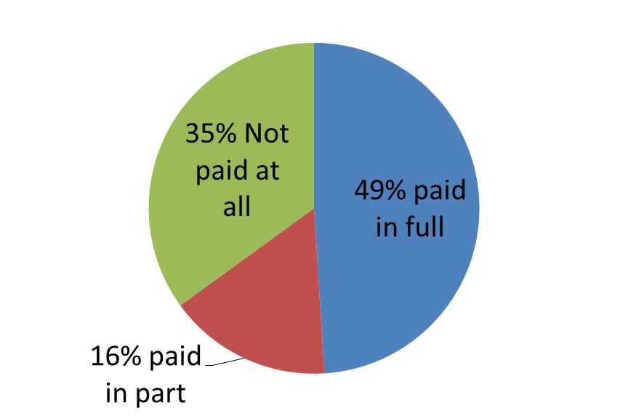
Effective remedies?
Non-enforcement of awards
Non-payment of ET awards – Department for Business, Innovation and Skills (2013) Payment of Tribunal Awards
49% received full payment of award
BUT 16% used enforcement action
35% of claimants received no payment
most common reason for non
-payment: employer
now insolvent (37%)
over half believed
company now trading
again under a different
name/location

Slide 11
Looking to the future: fair hearings
Defending fair hearing rights in civil disputes
  Adjudication system independent of workplace
  Abolition of tribunal fees
Equality of arms
  Role for TUs and advice agencies working together
  BUT complex legal procedures require legal support
Regulatory mechanisms for simple ‘low value’ claims?
  E.g. unpaid wages dealt with by system sim to minimum wage enforcement?
Inquisitorial approach?
  Judicial mediation

Slide 12
Looking to the future: enforcing awards
Government should play proactive role in enforcing employment tribunal awards
HMRC has enforcement officers for the minimum wage and to collect tax debt
  could be widened to cover enforcement of ET awards
Respondents could be required to make deposit with Tribunal

Slide 13
More information and comments
bristol.ac.uk/adviceagencyresearch/cab-project
nicole.busby@strath.ac.uk

